Slide 1
Unit 2
I think that mooncakes are
delicious!
Section A Grammar Focus-4c

Slide 2

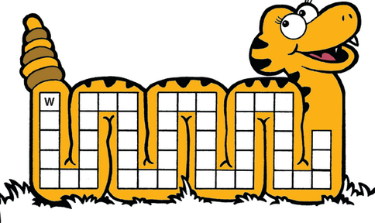

Words review
幻灯片上单词出现时，同学应迅速读出该单词并说出意思，说不出时，可有5秒钟的现场求救时间（向其他同学），每名同学接受求救不得超过3次。

Slide 3
folk
whoever
mooncake
admire
lay out
relative
lantern
steal
lay
put on
stranger
goddess
pound
garden
dessert
tradition

Slide 4
Grammar Focus
I know that the Water Festival is really fun. | What fun the Water Festival is.
I wonder if they’ll have the races again next year. | How fantastic the dragon boat teams were!
I wonder whether June is a good time to visit Hong Kong. | How pretty the dragon boats were.
I believe that April is the hottest month in Thailand. | How delicious the food is in Hong Kong!
PPT模板：www.1ppt.com/moban/ PPT素材：www.1ppt.com/sucai/
PPT背景：www.1ppt.com/beijing/ PPT图表：www.1ppt.com/tubiao/
PPT下载：www.1ppt.com/xiazai/ PPT教程： www.1ppt.com/powerpoint/
资料下载：www.1ppt.com/ziliao/ 范文下载：www.1ppt.com/fanwen/
试卷下载：www.1ppt.com/shiti/ 教案下载：www.1ppt.com/jiaoan/
PPT论坛：www.1ppt.cn PPT课件：www.1ppt.com/kejian/
语文课件：www.1ppt.com/kejian/yuwen/ 数学课件：www.1ppt.com/kejian/shuxue/
英语课件：www.1ppt.com/kejian/yingyu/ 美术课件：www.1ppt.com/kejian/meishu/
科学课件：www.1ppt.com/kejian/kexue/ 物理课件：www.1ppt.com/kejian/wuli/
化学课件：www.1ppt.com/kejian/huaxue/ 生物课件：www.1ppt.com/kejian/shengwu/
地理课件：www.1ppt.com/kejian/dili/ 历史课件：www.1ppt.com/kejian/lishi/
Notes:
PPT模板：www.1ppt.com/moban/ PPT素材：www.1ppt.com/sucai/
PPT背景：www.1ppt.com/beijing/ PPT图表：www.1ppt.com/tubiao/
PPT下载：www.1ppt.com/xiazai/ PPT教程： www.1ppt.com/powerpoint/
资料下载：www.1ppt.com/ziliao/ 范文下载：www.1ppt.com/fanwen/
试卷下载：www.1ppt.com/shiti/ 教案下载：www.1ppt.com/jiaoan/
PPT论坛：www.1ppt.cn PPT课件：www.1ppt.com/kejian/
语文课件：www.1ppt.com/kejian/yuwen/ 数学课件：www.1ppt.com/kejian/shuxue/
英语课件：www.1ppt.com/kejian/yingyu/ 美术课件：www.1ppt.com/kejian/meishu/
科学课件：www.1ppt.com/kejian/kexue/ 物理课件：www.1ppt.com/kejian/wuli/
化学课件：www.1ppt.com/kejian/huaxue/ 生物课件：www.1ppt.com/kejian/shengwu/
地理课件：www.1ppt.com/kejian/dili/ 历史课件：www.1ppt.com/kejian/lishi/

Slide 5
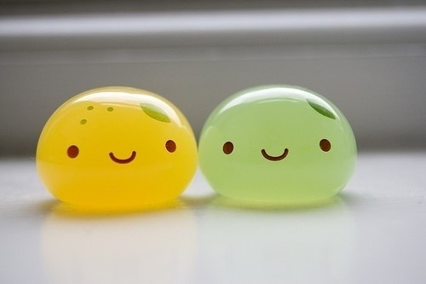
Objective clauses with that, if and
whether
Exclamatory statements
1.that,if和whether引导的宾语从句
2.感叹句

Slide 6
主语从句
subject clause
宾语从句
object clause
名词性从句
noun clause
表语从句
predicative clause
同位语从句
appositive clause

Slide 7
1.什么是宾语从句？
试比较：
We know him．
简单句
主s
谓v
宾o
复合句
We know he likes English.
主s
谓v
宾o
主s
谓v
宾o
宾语从句就是用一个句子来构成主句的宾语

Slide 8
Find out the Object Clauses
Do you know who is the first Chinese astronaut (宇航员)?
Our teacher told us that the earth goes around the sun.
Please tell me where she has gone.
I don’t know if he will come tonight.
Let’s find out what’s on tonight .

Slide 9
1.由从属连词that引导的宾语从句
e.g.
1.I hear (that) he will be back in an hour.
2.He said (that) he missed us very much.
注：that 在句中无词汇意义，在从句中不能充当成分，在口语当中往往省略。

Slide 10
that在宾语从句中的省略与保留
a. 在主+谓+it(形式宾语)+宾补+that 从句(真正宾语) 的句型中不省略.
eg: We must make it clear that we mean what we say.
b. 由连词and连接的两个由that引导的宾语从句中,第二个that 不省略.

Slide 11
eg: He told me（ that） he would come and that he would come on time.
c.当that作介词except, in等宾语时
e.g. They believe in that she must still be single.
I know nothing about him except that he is
living in Beijing.

Slide 12
2.由从属连词 whether, if 引导的宾语从句
if/whether 引导宾语从句 表示“是否”
if/whether可互换, 但whether…or not为固定搭配.
I want to know if/whether she is right .
They didn’t know whether Tom could come back or not .

Slide 13
注意whether和if的使用区别
1).whether和if都可以引导宾语从句
eg: I don’t know whether or not he will come.
注意：如果or not放在whether所引导的从句
句尾，则可以用if来替换。
I don’t know whether/if he will come or not.
eg: I worry about whether I hurt her feeling.
a.当whether后紧跟or not时,不用if.
b.介词后面的宾语从句不能用if.

Slide 14
c.在强调任意选择时,用whether…or,此时不用 if 替换whether。
He asked me whether I wanted to go there
by train or by bus.
他问我是想乘火车还是坐公共汽车去那里。
注：whether和or一起还有“不管”之意,引
导让步状语从句。
Whether he drives or takes the train, he
will be here on time.
不管开车来还是乘火车来，他都会准时到。

Slide 15
d. 虽引导宾语从句，但为了强调宾语部分，也可把从句放在句首，此时只用whether不用if。
e.g. Whether he will come I am not sure.
e.g. He asked me whether I’d move to New York if I got the job.
e. 句子中有if 引导的条件句，如再有表示“是否”的宾语从句，用whether不用if。

Slide 16
f. 容易产生歧义时用whether不用if来表示
“是否”。
Please let me know if you need help.
如果你需要帮助请告诉我。
或：请告诉我你是否需要帮助。对比：
Please let me know whether you need help.
请告诉我你是否需要帮助。
I don’t know if it won't rain tomorrow.
我不知道明天是不是会下雨。
g. 如果宾语从句为否定句时，则只用if不用whether。

Slide 17
2).引导主语从句置于句首时，只能用whether
e.g. Whether he comes or not makes no difference.
3). Whether可以引导表语从句和同位语从句，if不可以
4).用在动词不定式之前时用whether不用if。
I don’t know whether to go there at once.
我不知道是不是该立刻去那里。

Slide 18

3.由连接代词 Who, whom, whose, which, what 和连接副词 where, how, why, when引导的宾语从句
e.g.
1.Do you know whose book it is ?
2.Please tell me when we’ll have a meeting .
3.Could you tell me why the train is late?
4.He asked who could answer the question.

Slide 19
2. 宾语从句中时态的变化
当主句是一般现在时，宾语从句的时态不作限制，我们可以根据句子的意思来使用需要的任何一种时态。
Jim went to work an hour ago.
he is interested in English.
she will come tomorrow.
Tom has been to London twice.
I hear (that)

Slide 20
当主句是一般过去时的时候，宾语从句必须运用相应的过去的某一种时态，从而达到主句和从句的相互一致。
He will go to Hong Kong .
He is sick.
He is reading a book .
He has finished his work.
He would go to Hong Kong .
He was sick.
He said
He was reading a book .
He had finished his work.

Slide 21

当宾语从句说明的是客观存在的事实或者是客观存在的真理时，就不用受到主句时态的限制，仍是用一般现在时态。
He told me (that)
Summer is after Spring .
We kmew (that)
the sun is much bigger than the moon .
The teacher told us (that)
the earth moves around the sun.

Slide 22
主句时态 | 从句时态
一般现在时、一般将来时、祈使句时 | 根据句意的需要用任意一种时态
一般过去时 | 与原句相对应的过去的时态
客观事实、真理、自然现象、名言警句、谚语等 | 一律用一般现在时

Slide 23
3.宾语从句的语序
无论主句是陈述句还是疑问句，宾语从句都是运用陈述句的语序，即是“主语在前，谓语在后”的顺序。
Danny says that he will learn English.
Do you know where he came from?
Please tell me how I can get to the bus station .

Slide 24
that+陈述句
引导词
if／whether+一般疑问句
宾语从句三要素
特殊疑问词+特殊疑问句
主句为一般现在时
时态
从句可为任何时态
一般过去时
过去将来时
过去进行时
过去完成时
主句为一般过去时
从句客观真理时态不变
语序
宾语从句的语序都为陈述句语序

Slide 25

宾语从句歌
学习宾从三注意，时态语序和连词。
时态主从要呼应：
主句若为现在时，从句时态随句意；
主句若为过去时，从句时态变过去；
宾从若是表真理，时态不变无质疑。
语序要用陈述序，切莫照搬疑问句。
That 连接陈述句，省与不省要注意。
从句若表“是否”时，if/whether要慎记。
特殊问句作宾语，仍用原来疑问词。
三个问题需牢记，切莫丢东忘了西。

Slide 26
1. Tom said. He is reading a book.
→
2. He asks me. Are they playing a game?
→
3. Where is the hospital? He told me.
→
4.Who bought the pen? He wondered.
→
Tom said that he was reading a book.
He asks me if/whether they are playing a game.
He told me Where the Hospital was.
He wondered who bought the pen.

Slide 27
Who can answer the question？The teacher asked．
→The teacher asked who could answer the question．
What’s wrong? What’s the matter?
What’s happening? What happened?
Eg: I don’t know what’s the matter.

Slide 28
Exercises
1. The radio says it _______________cloudy tomorrow. (be)
2. The headmaster hopes everything _______well. (go)
3. Tom says that they ____________ (play) basketball at six o’ clock yesterday evening.
4. I hear they _________________ (return)
it already.
will be
goes
were playing
have returned

Slide 29
5. He said that they __________ members of the Party since 1948. (be)
6. He asked what they ____________ at eight last night. （do)
7. The teacher told his class that light _________ faster than sound. (travel)
8. I think you _____________ about the relay race now. （talk)
9. I didn’t know whom the letters ______from. (be)
had been
were doing
travels
are talking
were

Slide 30
用if 或whether 填空
1. I don’t know ___________ I’ll be free tomorrow.
2. I don’t know __________ or not I’ll be free tomorrow.
3. The question is __________ this book is worth writing.
whether/if
whether
whether

Slide 31

What 和 How引导的感叹句
所谓感叹句，就是用来表达喜怒哀乐等强烈情感的句子。近年来，感叹句的构成及转换是中考常考的考点之一。
感叹句一般由“what” 和“how”来开头的句子 “what”修饰名词，“how”修饰形容词和副词

Slide 32
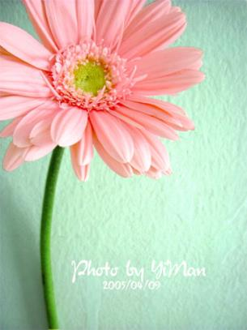
A beautiful flower
It is a very beautiful flower.
What a beautiful flower it is!

Slide 33


A lovely cat
It is a lovely cat.
What a lovely cat it is!
An interesting story book
It is an interesting story
book.
What an interesting story book it is!

Slide 34
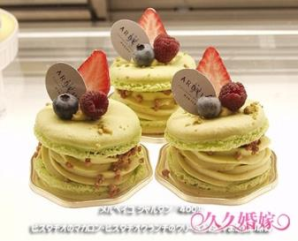
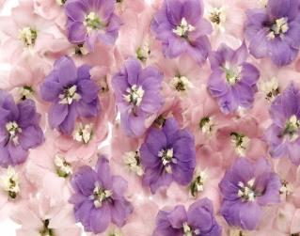
Beautiful flowers
Delicious cakes
They are delicious cakes.
What delicious cakes they are!
They are very beautiful
flowers.
What beautiful flowers
they are!

Slide 35
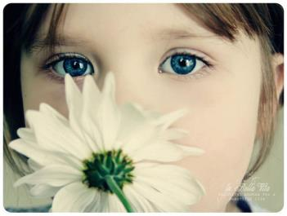
A pretty girl
She is a very pretty girl.
What a pretty girl she is !
Simple conclusion:
What+ a/an+adj.+n.+ it is/ she is/ he is…

Slide 36
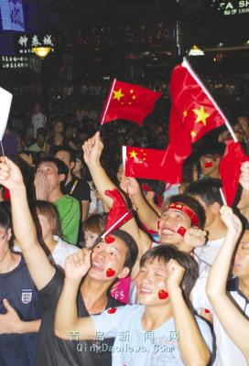
Exciting people
The people are exciting.
How exciting the people are!
Simple conclusion :
How +adj. +the+n. +is/are!

Slide 37
What 引导的感叹句
"what"意为"多么"用作定语，修饰名词（被强调部分），名词前可有其它定语成份（即：形容词或冠词）。单数可数名词前要加不定冠词a/an,复数可数名词或不可数名词前不用冠词。

Slide 38
一般有三种形式，此时what为形容词，作定
语，用来修饰它后面的名词或词组。
1. what+a/an+形容词+可数名词单数+主语+
谓语！
What an interesting story it is!
多么有趣的故事呀！
What a good girl she is!
她是个多么好的一个女孩啊！

Slide 39
2. what+形容词+不可数名词+主语+谓语！
What heavy snow it is! 多么大的雪呀！
What bad weather is it? 多么糟糕的天气！
3. what+形容词+可数名词复数+主语+谓语!
What beautiful flowers they are!
多么漂亮的花啊！
What good students they are!
他们是多么好的学生啊！

Slide 40
How 引导的感叹句
“how”意为“多么”，用作状语，修饰形容词或副词（被强调部分）。如果修饰形容词，则句中的谓语动词用系动词；如果how修饰副词，则句中的谓语动词用行为动词。

Slide 41
有三种结构形式。此时how是副词，用来修
饰其后的形容词或副词，也可以修饰动词。
1、How+形容词+主语+谓语！例如：
How cold it is today!
今天多么冷呀！
How hot it is today!
今天多么热呀！

Slide 42
2、How+副词+主语+谓语！ 例如：
How happy they look!
他们显得多么高兴呀！
How fast he runs!
他跑得多么快呀！
3、How+主语+谓语（陈述句）！例如：
How he loves his son!
他是多么的爱他的儿子！
How time flies! 光阴似箭！

Slide 43
表示同一意义时，感叹既可用“what” 引导，也可用"how"引导
① What a hot day it is!
How hot the day is !
多么热的天气呀！
② What tall buildings they are!
How tall the buildings are!
多么高的楼房呀！

Slide 44
③ What bad weather it is!
How bad the weather is!
多么糟糕的天气呀！
④ What bright sunshine it is!
How bright the sunshine is!
多么明亮的阳光呀！

Slide 45
表示激动强烈的感情时，口语中常省略其后面的主语和谓语
① What a fine day（it is）!
多么晴朗的天呀！
② What an honest boy!
多么诚实的孩子呀！
③ What red apples（they are)!
多么红的苹果呀！

Slide 46
④ How cool! 好凉快呀！
⑤ How wonderful! 精彩极了！
口语中常用:
What a pity! 真遗憾！
What a shame! 真遗憾!真可耻！

Slide 47
How VS What
how 修饰形容词，副词或动词:
How +形容词+ a +名词+ 陈述语序
How+形容词或副词+ 陈述语序
what修饰名词
What +名词+陈述语序
What+a+形容词+名词+ 陈述语序
What+ 形容词+复数名词+ 陈述语序
What+ 形容词+不可数名词+ 陈述语序

Slide 48

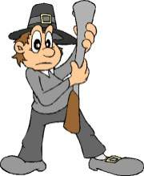
How tall the man is!
What a tall man (he is)!

Slide 49
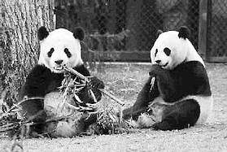
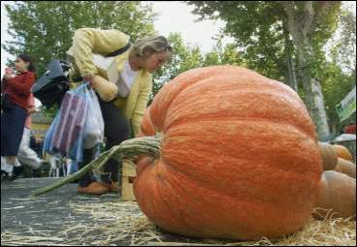
A. How lovely these
pandas are!
B. What lovely pandas
(they are)！
Wow, what a big
pumpkin!
How big this
pumpkin is!

Slide 50
4a Write sentences using the words given.
1. think/Lantern Festival/beautiful
I think that the Lantern Festival is beautiful.
2. don’t know /whether /he /come home /
for the festival
_____________________________________
_____________________________________
3. believe/Water Festival/most/fun
________________________________________
I don’t know whether he will come home for the festival.
I believe that the Water Festival is the most fun.

Slide 51
4. wonder/if/mooncakes/delicious
______________________________________
5. how/exciting/races
______________________________________
6. what/interesting/city
_______________________________________
Jenny wonders if the mooncakes are delicious.
How exciting the races are!
What an interesting city ( it is)!

Slide 52
4b Read the passage below and underline the objective clauses. If possible write your own sentences about Mother’s Day and Father’s Day using objective clauses.
Dear Xia Yu,
Do you know that there are two special days for parents in America? One is Mother’s Day on the second Sunday of May and the other is Father’s Day on the third Sunday of June. On these two days, American children often give gifts to their parents or take them out

Slide 53
for lunch or dinner. Common gifts are flowers and cards for mothers and shirts or ties for fathers. I heard that it is becoming more and more popular to celebrate Mother’s Day and Father’s Day in China. I wonder if children over there also give similar gifts to their parents. I believe that there are many ways to show our love. Actually, we don’t have to spend a lot of money. It is also a good idea to help parents to do something instead.
June

Slide 54
Objective clause:
1. Do you know that there are two special days
for parents in America?
2. I heard that it is becoming more and more
popular to celebrate Mother’s Day and
Father’s Day in China.
3. I wonder if children over there also give
similar gifts to their parents.
4. I believe that there are many ways to show
our love.

Slide 55
Language Points
Actually, we don’t have to spend a lot of money. 事实上，我们不必花很多钱。
have to 意为“必须；不得不”，强调由于客
观因素主语不得不做某事，有人称和时态的变
化，其后跟动词原形。
► Because he had no money, he had to drop
out of school.
因为没有钱，他不得不辍学。

Slide 56
have to 与 must
have to: “必须；不得不”，表示客观需要，
有人称、数、时态的变化。
don’t have to 表示“不必”
must : “必须; 一定” 表示说话人主观上的看
法，must 只有一种形式。
mustn’t 表示“禁止”
► You don’t have to tell him about it.
你不必把这件事告诉他。
► You mustn't tell him about it.
你一定不要把这件事告诉他。

Slide 57
(2) spend 动词，意为“用，花”，常用句型为
spend some time/ money ( in ) doing sth.
花费时间/钱做某事。spend 后接动词的-ing。
► I spent two hour (in) reading the novel.
我花了两小时读这篇小说。
► I spent 100 yuan buying the sweater.
我花了100元买这件毛衣。

Slide 58

4c Which festival do you like best? Ask your group and report to the class.
e.g. In our group, David’s favorite festival is ... He thinks that …

Slide 59
Sample:
In our group, David’s favorite festival is Halloween. He thinks that on that day children will wear special costumes with mask to take part in Halloween party. And play “trick or treat”.

Slide 60
Exercises
典型例题
1）___ food you've cooked!
A. How a nice B. What a nice
C. How nice D. What nice
2）___terrible weather we've been having these days!
A. What B. What a C. How D. How a
3) ______ food you've cooked!
A. How a nice B. What a nice
C. How nice D. What nice
D
A
D

Slide 61
4.______beautiful day it is! Let's go and have a
picnic in the park.
A.How B.How a C.What D.What a
5._______wonderful news report he wrote!
A.What a B.What C.Which D.Weather
6.—With the help of doctors, the boy can see
again. —_______he is!
A.What luckly B.What a luck
C. How luck D.How a luck
D
B
C

Slide 62
What 与How 大转换
1. What a pretty girl she is!
_______ _______ the girl is!
2. How difficult the questions are!
_________ ________ ________ they are.
3. How big the factory is!
_______ _______ big factory _____ ____!
How pretty
What difficult questions
What a
it is

Slide 63
4.What a clever boy!
_______ _______ the boy _______!
5. How tall the trees are!
_______ tall trees ______ ______!
6. What interesting books they are!
____ ___________ the books ________!
7. How funny the girl is!
________ _______ funny girl ____ _____!
How clever
is
What
they are
How interesting
are
What a
she is

Slide 64
8. How old the man is!
______ _______ old man ______ _____!
9. What nice books they are!
_____ ______ the books ________!
10. How amazing the building is!
_____ _____amazing building ____ ____!
What an
he is
How nice
are
What an
it is

Slide 65
将下列句子改为感叹句
The girl is very pretty.
How pretty the girl is!
What a pretty girl she is!
2. This is an old watch.
How old this watch is!
What an old watch it (this) is!

Slide 66
3. The food is so nice.
How nice the food is!
What nice food it is!
4. These questions are very easy.
How easy these questions are!
What easy questions these are!
5. She has long hair.
How long her hair is!
What long hair she has!

Slide 67
根据汉语提示，完成句子。
that his father will be back
1.He says_______________________
____________.(他说他爸爸三天后回来)
2.Our teacher asks _____________
___________________.(昨天谁打碎了玻璃)
3.Please tell me_____________
____________.(他们正在谈论什么)
in three days
who broke the
window yesterday
what they are
talking about

Slide 68
Find out the mistakes and correct.
1. Could you tell me where do they live?
2. She knew that Danny is a student.
3. He told me that winter was colder than
autumn.
was
is

Slide 69
Homework
Practice more exercise to master
the grammar learnt in this part.

